Slide 1
Connecting Smart Object
Module-2

Slide 2
Communication Criteria
Range
Frequency Bands
Power Consumptions
Topology
Constrained Devices
Constrained-Node Networks

Slide 3
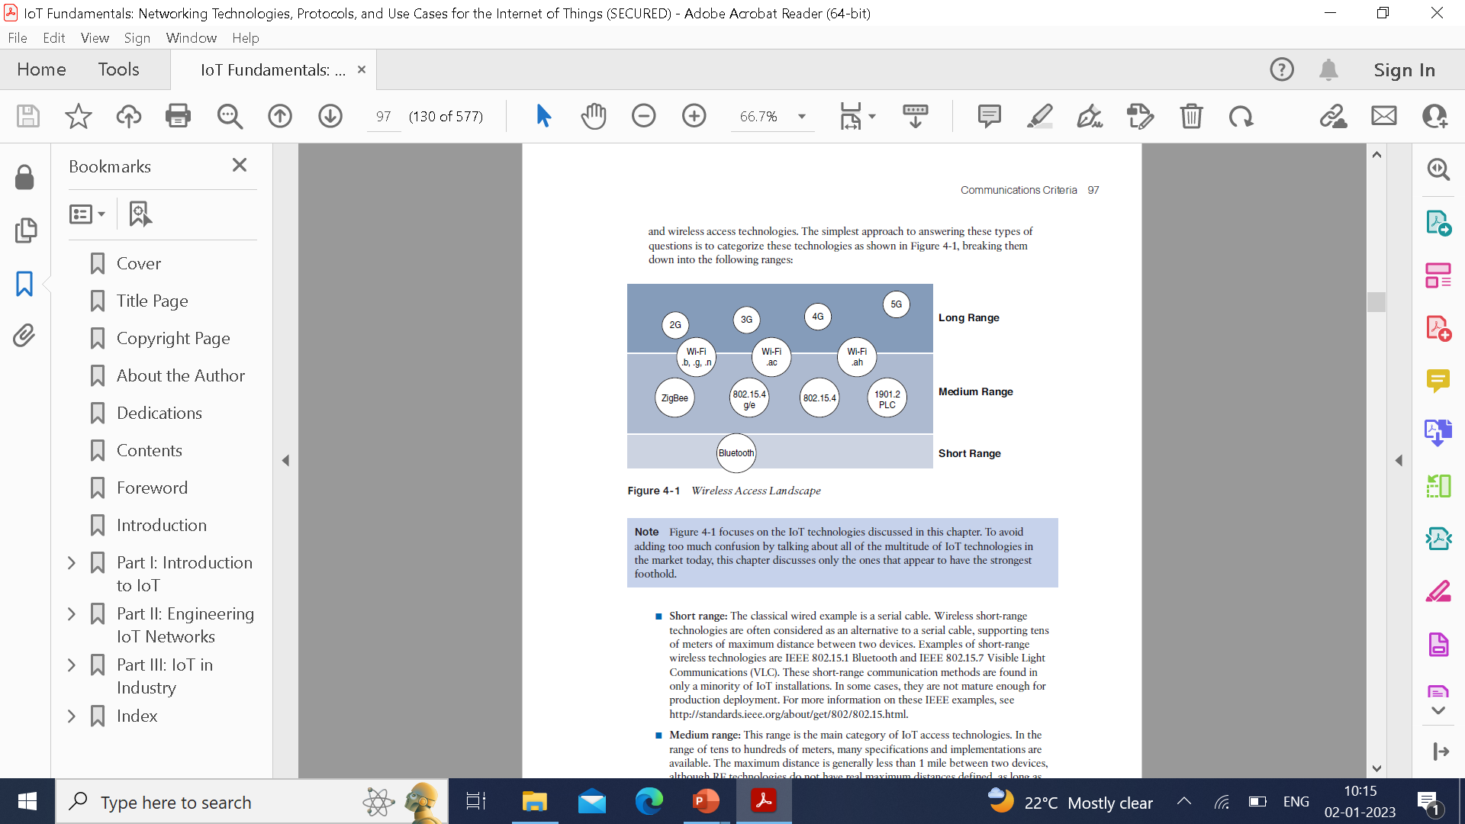
Range
Short Range:
Classical wired serial cable. Wireless short-range technologies are often considered as an alternate to a serial cable, supporting tens meters of maximum distance between two device. E.g. IEEE802.15.1 Bluetooth and IEEE802.15.7 Visible Light Communications (VLC).
Found in minor IoT Installations

Slide 4
Medium Range:
Main category of IoT access technologies.
Range of tens to hundred meters
Maximum distance is less than 1 mile between two devices.
E.g. IEEE802.11 Wi-Fi, IEEE802.15.4 and 802.15.4g WPAN.
Wired technologies such as IEEE802.3 Ethernet and IEEE1901.2 Narrowband Power Line Communications(PLC)

Slide 5
Long Range:
Distance greater than 1 mile between two devices require long-range technologies.
Wireless examples are cellular(2G,3G,4G)
Some outdoor applications are IEEE802.11 WI-FI and Low-Power Wide-Area(LPWA)
Ideal for battery-powered IoT sensors.

Slide 6
Frequency Bands
Radio spectrum is regulated by countries and/or organizations, such as the International Telecommunication Union (ITU) and the Federal Communications Commission (FCC).
These groups define the regulations and transmission requirements for various frequency bands. For example, portions of the spectrum are allocated to types of telecommunications such as radio, television, military, and so on.
Focusing on IoT access technologies, the frequency bands leveraged by wireless communications are split between licensed and unlicensed bands. Licensed spectrum is generally applicable to IoT long-range access technologies and allocated to communications infrastructures deployed by services providers, public services (for example, first responders, military), broadcasters, and utilities.
An important consideration for IoT access infrastructures that wish to utilize licensed spectrum is that users must subscribe to services when connecting their IoT devices. This adds more complexity to a deployment involving large numbers of sensors and other IoT devices, but in exchange for the subscription fee, the network operator can guarantee the exclusivity of the frequency usage over the target area and can therefore sell a better guarantee of service.

Slide 7
The ITU has also defined unlicensed spectrum for the industrial, scientific, and medical (ISM) portions of the radio bands. These frequencies are used in many communications technologies for short-range devices (SRDs). Unlicensed means that no guarantees or protections are offered in the ISM bands for device communications. For IoT access, these are the most well-known ISM bands:
■ 2.4 GHz band as used by IEEE 802.11b/g/n Wi-Fi
■ IEEE 802.15.1 Bluetooth
■ IEEE 802.15.4 WPAN
ISM bands operate in the sub-GHz range. Sub-Ghz bands are used by protocol such as IEEE802.15.4g 802.11ah,802.15.4 and LWPA technologies such as LoRa and Sigfox.
Either indoor or outdoor deployments, the sub-GHz frequency bands allow greater distances between the devices. These bands have a better ability than the 2.4GHz ISM band to penetrate building infrastructure or go around obstacles, while keeping the transmitting power within regulation.
The disadvantage of sub-GHz frequency bands is their lower rate of delivery compared to higher frequencies. IoT sensors do not need to send data at high rates. The most well-known ranges are centred on 169 MHz, 433MHz,868MHz and 915MHz.

Slide 8
Power Consumption
IoT devices is very broad, there is a clear delineation between powered nodes and battery-powered nodes.
A powered node has a direct connection to a power source, and communications are usually not limited by power consumption criteria.
Power nodes are limited by the availability of a power source, which makes mobility more complex.
Battery-powered nodes bring much more flexibility to IoT devices. These nodes are often classified by the required lifetimes of their batteries.

Slide 9
Batteries can be changed or the devices replaced when a street gets resurfaced. A battery life is 2 or 3 years is an option.
Low-Powered Wide-Area it is possible to run any wireless technologies on batteries.
For deployment of smart meters over PLC, the radio interference on meters can’t consume 5 to 10 watts or this will add up to 20-million-meter deployment consuming 100 to 200 megawatts.

Slide 10
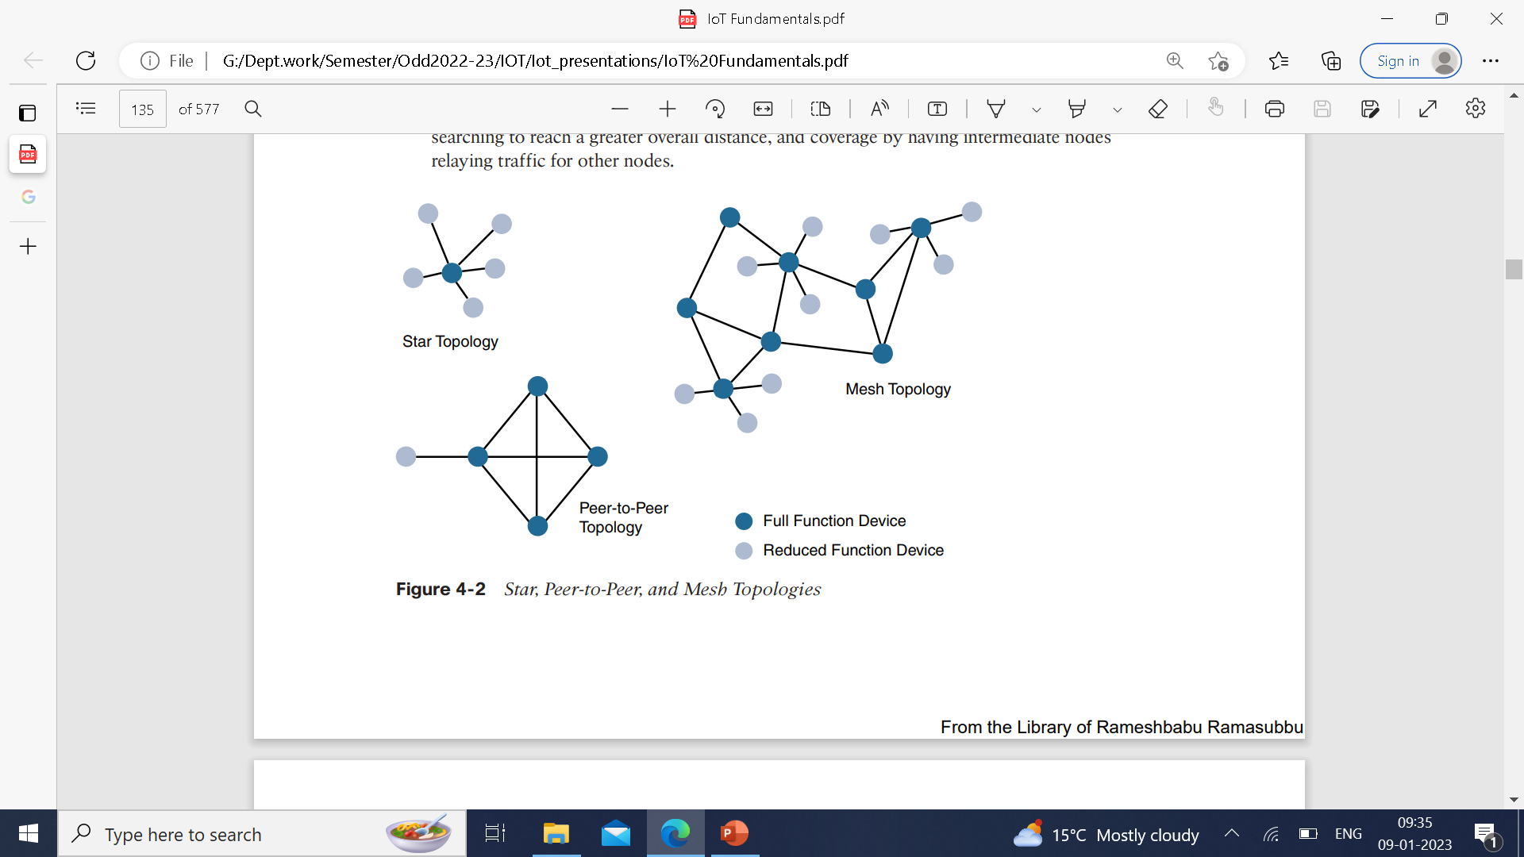
Topology
Three main topologies are dominant: star, mesh and peer-to-peer.
Long-range and short range technologies a star topology is prevalent as seen with cellular, LPWA and Bluetooth network.
Star topology utilize a single central base station or controller to allow communication with end points.
For medium range technologies, a star, peer-to-peer or mesh topology is common.

Slide 11
Peer-to-peer allow any device to communicate with any other device as long as they are in range of each other. Peer-to-peer topologies rely on multiple full-function devices. peer-to-peer topologies enable more complex formations, such as mesh networking topology.
For example, indoor Wi-Fi deployments are mostly a set of nodes forming a star topology around their access points (APs). Meanwhile, outdoor Wi-Fi may consist of a mesh topology for the backbone of APs, with nodes connecting to the APs in a star topology.
Similarly, IEEE 802.15.4 and 802.15.4g and even wired IEEE 1901.2a PLC are generally deployed as a mesh topology. A mesh topology helps cope with low transmit power, searching to reach a greater overall distance, and coverage by having intermediate nodes relaying traffic for other nodes.
Mesh topology requires the implementation of a Layer 2 forwarding protocol known as mesh-under or a Layer 3 forwarding protocol referred to as mesh-over on each intermediate node. While well adapted to powered nodes, mesh topology requires a properly optimized implementation for battery-powered nodes. Battery-powered nodes are often placed in a “sleep mode” to preserve battery life when not transmitting.
In the case of mesh topology, either the battery-powered nodes act as leaf nodes or as a “last resource path” to relay traffic when used as intermediate nodes. Otherwise, battery lifetime is greatly shortened. For battery-powered nodes, the topology type and the role of the node in the topology

Slide 12

Constrained Devices
The Internet Engineering Task Force (IETF) acknowledges in RFC 7228 that different categories of IoT devices are deployed. While categorizing the class of IoT nodes is a perilous exercise, with computing, memory, storage, power, and networking continuously evolving and improving, RFC 7228 gives some definitions of constrained nodes.
These definitions help differentiate constrained nodes from unconstrained nodes, such as servers, desktop or laptop computers, and powerful mobile devices such as smart phones.

Slide 13
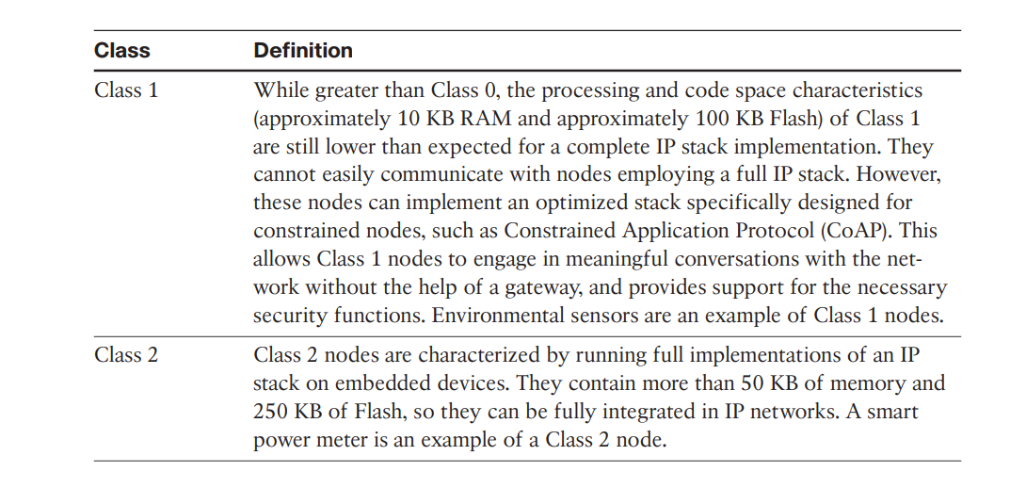

Slide 14
Constrained-node Networks
While several of the IoT access technologies, such as Wi-Fi and cellular, are applicable to laptops, smart phones, and some IoT devices, some IoT access technologies are more suited to specifically connect constrained nodes.
Typical examples are IEEE 802.15.4 and 802.15.4g RF, IEEE 1901.2a PLC, LPWA, and IEEE 802.11ah access technologies.
Low-power in the context of LLNs refers to the fact that nodes must cope with the requirements from powered and battery powered constrained nodes. Lossy networks indicates that network performance may suffer from interference and variability due to harsh radio environments.
Layer 1 and Layer 2 protocols that can be used for constrained-node networks must be evaluated in the context of the following characteristics for use-case applicability: data rate and throughput, latency and determinism, and overhead and payload.

Slide 15
Data Rate and Throughput
The data rates available from IoT access technologies range from 100 bps with protocols such as Sigfox to tens of megabits per second with technologies such as LTE and IEEE 802.11ac.
Therefore, understanding the bandwidth requirements of a particular technology, its applicability to given use cases, the capacity planning rules, and the expected real throughput are important for proper network design and successful production deployment.
Technologies not particularly designed for IoT, such as cellular and Wi-Fi, match up well to IoT applications with high bandwidth requirements. For example, nodes involved with video analytics have a need for high data rates.
These nodes are found in retail, airport, and smart cities environments for detecting events and driving actions. Because these types of IoT endpoints are not constrained in terms of computing or network bandwidth, the design guidelines tend to focus on application requirements, such as latency and determinism.

Slide 16
Short-range technologies can also provide medium to high data rates that have enough throughput to connect a few endpoints. For example, Bluetooth sensors that are now appearing on connected wearables fall into this category.
In this case, the solutions focus more on footprint and battery lifetime than on data rate. The IoT access technologies developed for constrained nodes are optimized for low power consumption, but they are also limited in terms of data rate, which depends on the selected frequency band, and throughput.
Another characteristic of IoT devices is that a majority of them initiate the communication. Upstream traffic toward an application server is usually more common than downstream traffic from the application server. Understanding this behavior also helps when deploying an IoT access technology, such as cellular, that is asymmetrical because the upstream bandwidth must be considered a key parameter for profiling the network capacity

Slide 17
Latency and Determinism
On constrained networks, latency may range from a few milliseconds to seconds, and applications and protocol stacks must cope with these wide-ranging values.
For example, UDP at the transport layer is strongly recommended for IP endpoints communicating over LLNs. In the case of mesh topologies, if communications are needed between two devices inside the mesh, the forwarding path may call for some routing optimization, which is available using the IPv6 RPL protocol.

Slide 18
Overhead and Payload
The minimum IPv6 MTU size is expected to be 1280 bytes. Therefore, the fragmentation of the IPv6 payload has to be taken into account by link layer access protocols with smaller MTUs.
For technologies that fall under the LLN definition but are able to transport IP, such as IEEE 802.15.4 and 802.15.4g, IEEE 1901.2, and IEEE 802.11ah, Layer 1 or Layer 2 fragmentation capabilities and/or IP optimization is important.
For example, the payload size for IEEE 802.15.4 is 127 bytes and requires an IPv6 payload with a minimum MTU of 1280 bytes to be fragmented. On the other hand, IEEE 802.15.4g enables payloads up to 2048 bytes, easing the support of the IPv6 minimum MTU of 1280 bytes.
These small payload sizes are defined to cope with the low data rate and time over the air or duty cycle requirements of IoT nodes and sensors.
For example, payloads may be as little as 19 bytes using LoRaWAN technology or up to 250 bytes, depending on the adaptive data rate (ADR). While this doesn’t preclude the use of an IPv6/6LoWPAN payload, as seen on some endpoint implementations, these types of protocols are better suited to Class 0 and 1 nodes, as defined in RFC 7228.

Slide 19
In conclusion, the communication criteria just covered are fundamental to understanding IoT access technologies, their characteristics, and when they are most applicable. These criteria include range, frequency bands, power consumption, network topology, the presence of constrained devices and/or networks, and data throughput.

Slide 20
IoT Access Technologies
Particularly, the following topics are addressed for each IoT access technology:
■ Standardization and alliances: The standards bodies that maintain the protocols for a technology
■ Physical layer: The wired or wireless methods and relevant frequencies
■ MAC layer: Considerations at the Media Access Control (MAC) layer, which bridges the physical layer with data link control
■ Topology: The topologies supported by the technology
■ Security: Security aspects of the technology
■ Competitive technologies: Other technologies that are similar and may be suitable alternatives to the given technology

Slide 21
IEEE802.15.4
It runs on batteries.
Low cost, reasonable batteries and easy installation.
It focuses on MAC reliability, unbounded latency and suspectable interference and multipath fading.
Collision Sense Multiple Access/Collision Avoidance(CSMA/CA) is an access method in which device listens to make sure that no other devices are transmitting before starting its own transmission.
Interference and multipath fading occurs in IEEE802.15.4 because it lacks frequency hopping.

Slide 22
IEEE802.15.4 Continued…
Commonly found deployments are:
Home and building Automation
Automotive networks
Industrial wireless sensor networks
Interactive toys and remote controls

Slide 23
Standardization and Alliances of IEEE802.15.4
It defines low-data-rate for PHY and MAC layer specifications for wireless personal area network(WPAN).
Since 2003, IEEE has published several iterations of 802.15.4 specification, each labeled with the year.
For example, IEEE802.15.4-2003 was published in the year 2003, 802.15.4-2006 in 2006, 802.15.4-2011 in 2011 and 802.15.4-2015 in 2015.
Newer releases typically supersede older ones.

Slide 24
Protocol Stack utilizing 802.15.4
Protocol | Description
ZigBee | Promoted through ZigBee Alliance. It defines upper layer components and application profiles. Common profiles include building automation, home automation and health care. It also defines device object function such as device role, device discovery, network join and security.
6LoWPAN | It is an IPv6 adaption layer defined by IETF 6LoWPAN working group that describes how to transport IPv6 packets over IEEE802.15.4 layers. RFCs document header compression and IPv6 enhancements cope with the specific details of IEEE 802.15.4.
ZigBee IP | An evolution of the ZigBee protocol stack. ZigBee adopts the 6LoWPAN adaption layer, IPv6 network layer and RPL routing protocol.
ISA100.11a | It is developed by International Society of Automation(ISA) as wireless systems for Automation: Process Control and Related Applications.It is based on IEEE802.15.4-2006 and specifications were published in 2010 and then as IEC 62734. The network and transport layers are based on IETF 6LoWPAN, IPv6 and UDP standards.

Slide 25
Continued…
WirelessHART | WirelessHART, promoted by the HART Communication Foundation, is a protocol stack that offers a time-synchronized, self-organizing, and self-healing mesh architecture, leveraging IEEE802.15.4-2006 over 2.4GHz frequency band.
Thread | Constructed on top of TETF 6LoWPAN/IPv6, Thread is a protocol stack for a secure and reliable mesh network to connect and control products in the home.

Slide 26
ZigBee
It was ratified in 2004 after the release of IEEE802.15.4
Evolving ZigBee as an IoT solution for interconnecting smart objects.
ZigBee solutions are aimed at smarter objects and sensors that have low band width and low power needs.
Set of commands and message types were introduced in 2006 and numbers increased in 2007 called as ZigBee pro to achieve different functions for a device, such as metering, temperature or lighting control.
These set of commands and messages are called clusters.

Slide 27
ZigBee continued…
The ZigBee are well-known in the following areas:
Automation for commercial and retail
home applications
Smart energy
In the industrial and commercial automation: ZigBee-based device handles measuring temperature, humidity.
In home automation: ZigBee can control lighting, thermostats and security functions.
ZigBee smart energy brings together a variety of interoperable products such as smart meters, that can monitor and control the use and delivery of utilities such as electricity and water.

Slide 28
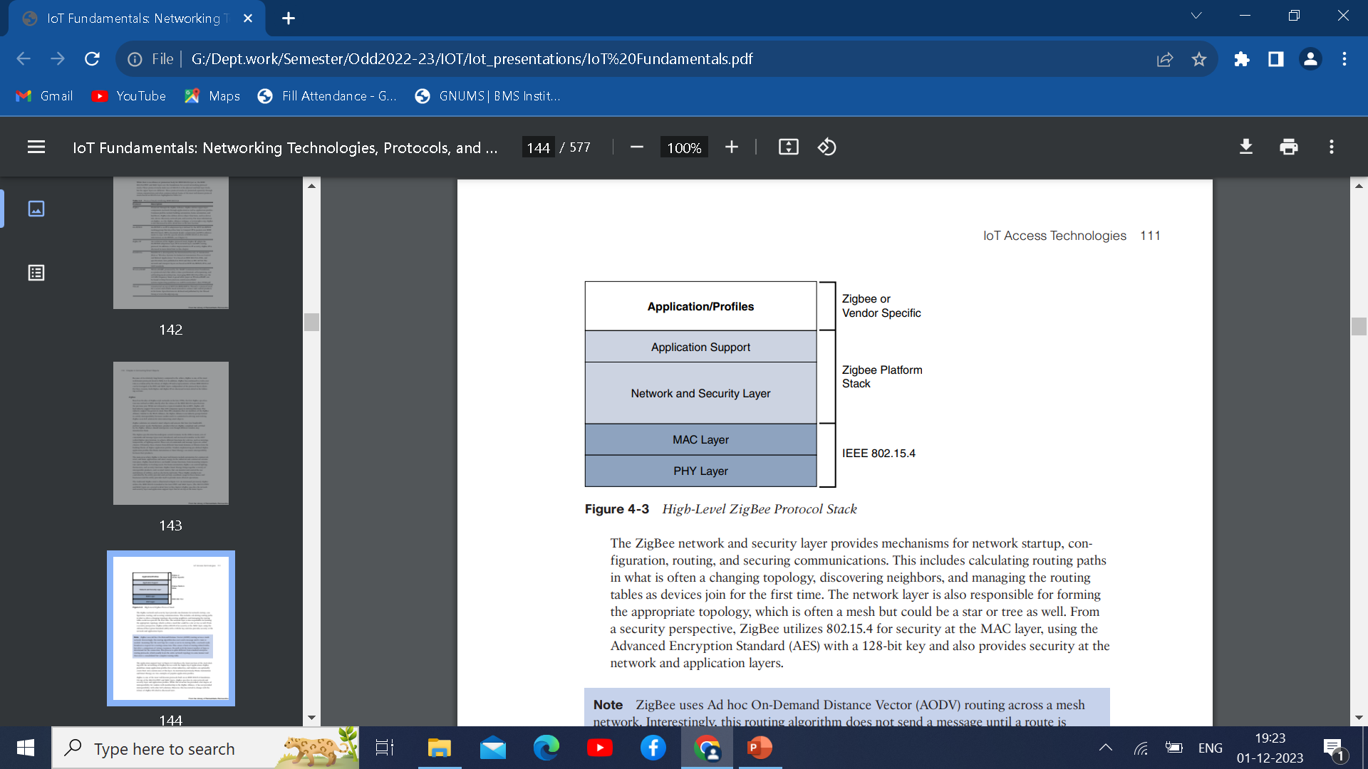
These ZigBee products are controlled by the utility provider and can help coordinate usage between homes and businesses and the utility provider itself to provide more efficient operations.
The ZigBee network and security layer provides mechanisms for network startup, configuration, routing, and securing communications.
This includes calculating routing paths in what is often a changing topology, discovering neighbors, and managing the routing tables as devices join for the first time.

Slide 29
The network layer is also responsible for forming the appropriate topology, which is often a mesh but could be a star or tree as well. From a security perspective, ZigBee utilizes 802.15.4 for security at the MAC layer, using the Advanced Encryption Standard (AES) with a 128-bit key and also provides security at the network and application layers.
The application support layer in Figure 4-3 interfaces the lower portion of the stack dealing with the networking of ZigBee devices with the higher-layer applications.
ZigBee predefines many application profiles for certain industries, and vendors can optionally create their own custom ones at this layer.

Slide 30
ZigBee IP
ZigBee IP was created to embrace the open standards coming from the IETF’s work on LLNs, such as IPv6, 6LoWPAN, and RPL.
ZigBee IP is a critical part of the Smart Energy (SE) Profile 2.0 specification from the ZigBee Alliance. SE 2.0 is aimed at smart metering and residential energy management systems.
In fact, ZigBee IP was designed specifically for SE 2.0 but it is not limited to this use case.
The 6LoWPAN mesh addressing header is not required as ZigBee IP utilizes the mesh over or route-over method for forwarding packets. ZigBee IP requires the support of 6LoWPAN’s fragmentation and header compression schemes.
At the network layer, all ZigBee IP nodes support IPv6, ICMPv6, and 6LoWPAN Neighbor Discovery (ND), and utilize RPL for the routing of packets across the mesh network.

Slide 31
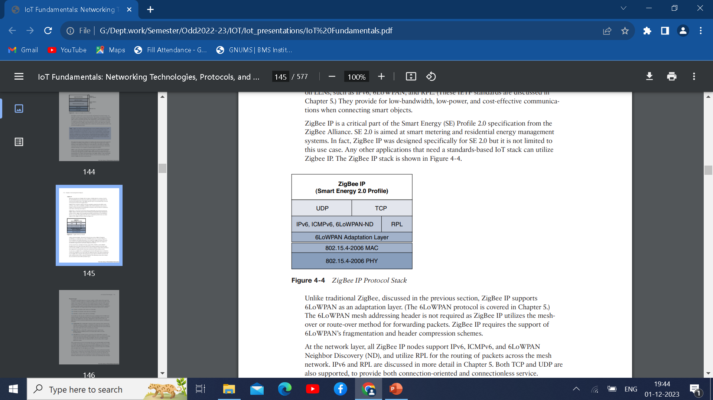
ZigBee IP Continued…
ZigBee IP is a compelling protocol stack offering because it is based on
current IoT standards at every layer under the application layer. This opens up opportunities for ZigBee IP to integrate and interoperate on just about any 802.15.4 network with other solutions built on these open IoT standards.

Slide 32
Physical Layer
The 802.15.4 standard supports an extensive number of PHY options that range from 2.4 GHz to sub-GHz frequencies in ISM bands. The original IEEE 802.15.4-2003 standard specified only three PHY options based on direct sequence spread spectrum (DSSS) modulation.
DSSS is a modulation technique in which a signal is intentionally spread in the frequency domain, resulting in greater bandwidth.
The original physical layer transmission options were as follows:
■ 2.4 GHz, 16 channels, with a data rate of 250 kbps
■ 915 MHz, 10 channels, with a data rate of 40 kbps
■ 868 MHz, 1 channel, with a data rate of 20 kbps

Slide 33
Physical Layer
The 915 MHz band operates mainly in North and South America, and the 868 MHz frequencies are used in Europe, the Middle East, and Africa. IEEE 802.15.4-2006, 802.15.4-2011, and IEEE 802.15.4-2015 introduced additional PHY communication options, including the following:
OQPSK PHY: This is DSSS PHY, employing offset quadrature phase-shift keying
(OQPSK) modulation. OQPSK is a modulation technique that uses four unique bit values that are signaled by phase changes. An offset function that is present during phase shifts allows data to be transmitted more reliably.
BPSK PHY: This is DSSS PHY, employing binary phase-shift keying (BPSK) modulation. BPSK specifies two unique phase shifts as its data encoding scheme.

Slide 34
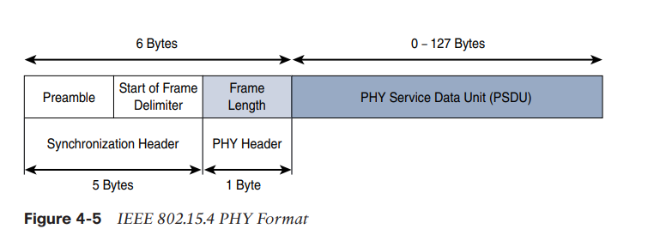
ASK PHY: This is parallel sequence spread spectrum (PSSS) PHY, employing amplitude shift keying (ASK) and BPSK modulation. PSSS is an advanced encoding scheme that offers increased range, throughput, data rates, and signal integrity compared to DSSS. ASK uses amplitude shifts instead of phase shifts to signal different bit values.
Figure 4-5 shows the frame for the 802.15.4 physical layer. The synchronization header for this frame is composed of the Preamble and the Start of Frame Delimiter fields. The Preamble field is a 32-bit 4-byte pattern that identifies the start of the frame and is used to synchronize the data transmission.

Slide 35
The PHY Header portion of the PHY frame shown in Figure 4-5 is simply a frame length value. It lets the receiver know how much total data to expect in the PHY service data unit (PSDU) portion of the 802.4.15 PHY. The PSDU is the data field or payload.

Slide 36
MAC Layer
At this layer, the scheduling and routing of data frames are also considered. The 802.15.4 MAC layer performs the following tasks:
Network beaconing for devices acting as coordinators
PAN association and disassociation by a device
Device security
Reliable link communications between two peer MAC entities.

Slide 37
MAC Layer continued
The MAC layer achieves these tasks by using various predefined frame types. In fact, four types of MAC frames are specified in 802.15.4:
Data frame: Handles all transfer of data
Beacon frame: used in the transmission of beacons from a PAN coordinator
Acknowledge frame: Confirms the successful reception of a frame
MAC Command frame: Responsible for control Communication between devices.

Slide 38
MAC Layer
The MAC Header field is composed of the Frame Control. Sequence Number and the Addressing fields. The Frame Control field defines attributes such as frame types, addressing modes and other control flags.
The Sequence Number field indicates the sequence identifier for the frame. The addressing field specifies the source and the Destination PAN Identifier fields as well as the Source and Destination Address fields.
The MAC payload field varies by individual frame type. For example, beacon frames have specific fields and payloads related to beacons, while MAC command frames have different field present. The MAC Footer field is nothing more than a frame check sequence(FCS).
An FCS is a calculation based on the data in the frame that is used by the receiving side to confirm the integrity of the data in the frame.

Slide 39
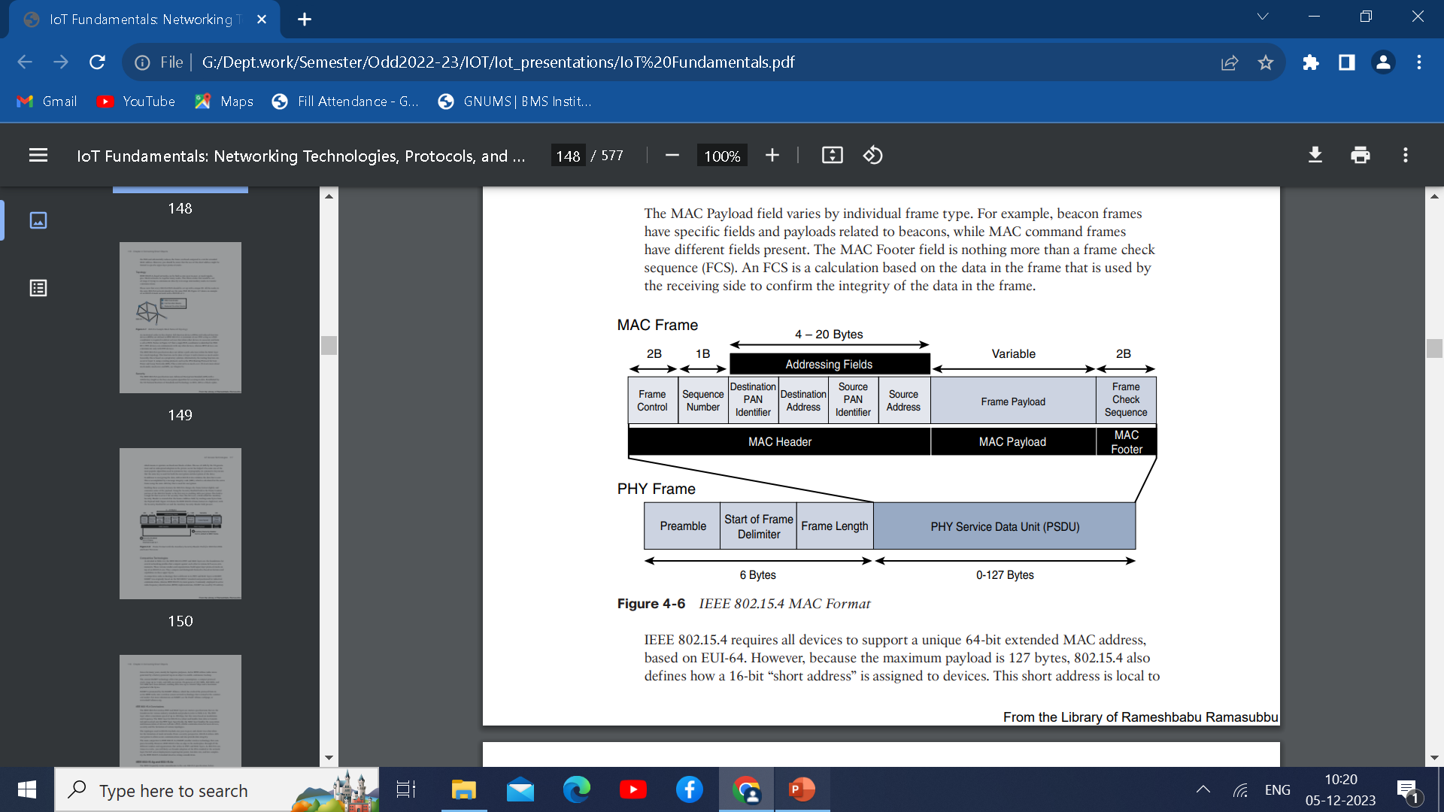
IEEE 802.15.4 requires all devices to support a unique 64-bit extended MAC address, based on EUI-64.
Maximum payload is 127 bytes.
802.15.4 defines 16-bit “short address” is assigned to devices.

Slide 40
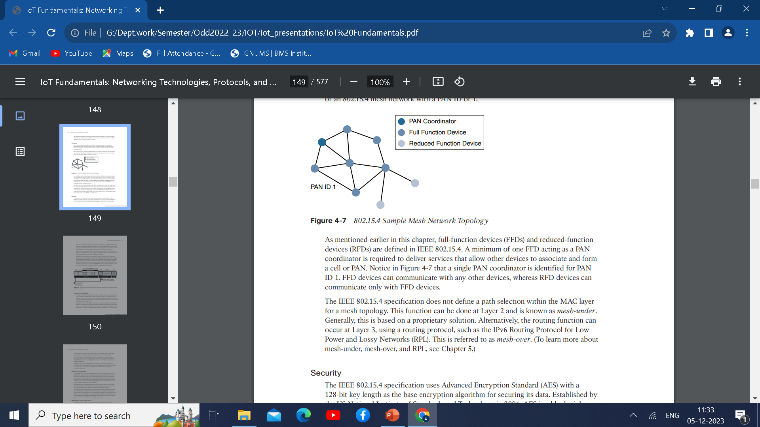
Topology
IEEE 802.15.4-based networks can be built as star, peer-to-peer, or mesh topologies. Mesh networks tie together many nodes.
802.15.4 PAN should set up with a unique ID. All the nodes in the same 802.15.4 network should use the same PAN ID.
Full-function devices(FFDs) and reduced-function devices(RFDs) are defined in 802.15.4.
A minimum of one FFD acting as a PAN
Coordinator is required to deliver services
that allow other devices to associate and form
a cell or PAN.

Slide 41
A single PAN coordinator is identified for PAN ID 1. FFD devices can communicate with any other devices, whereas RFD devices can communicate only with FFD devices.
The IEEE 802.15.4 specification does not define a path selection within the MAC layer
for a mesh topology. This function can be done at Layer 2 and is known as mesh-under.
Alternatively, the routing function can occur at Layer 3, using a routing protocol, such as the IPv6 Routing Protocol for Low Power and Lossy Networks (RPL). This is referred to as mesh-over.

Slide 42
Security
The IEEE 802.15.4 specification uses Advanced Encryption Standard (AES) with a 128-bit key length as the base encryption algorithm for securing its data.
Established by the US National Institute of Standards and Technology in 2001, AES is a block cipher, which means it operates on fixed-size blocks of data.
The use of AES by the US government and its widespread adoption in the private sector has helped it become one of the most popular algorithms used in symmetric key cryptography.
To encrypt the data, AES in 802.15.4 validates the data that is sent.
It is accomplished by a message integrity code(MIC), which is calculated for the entire frame using the same AES key that is used for encryption.

Slide 43
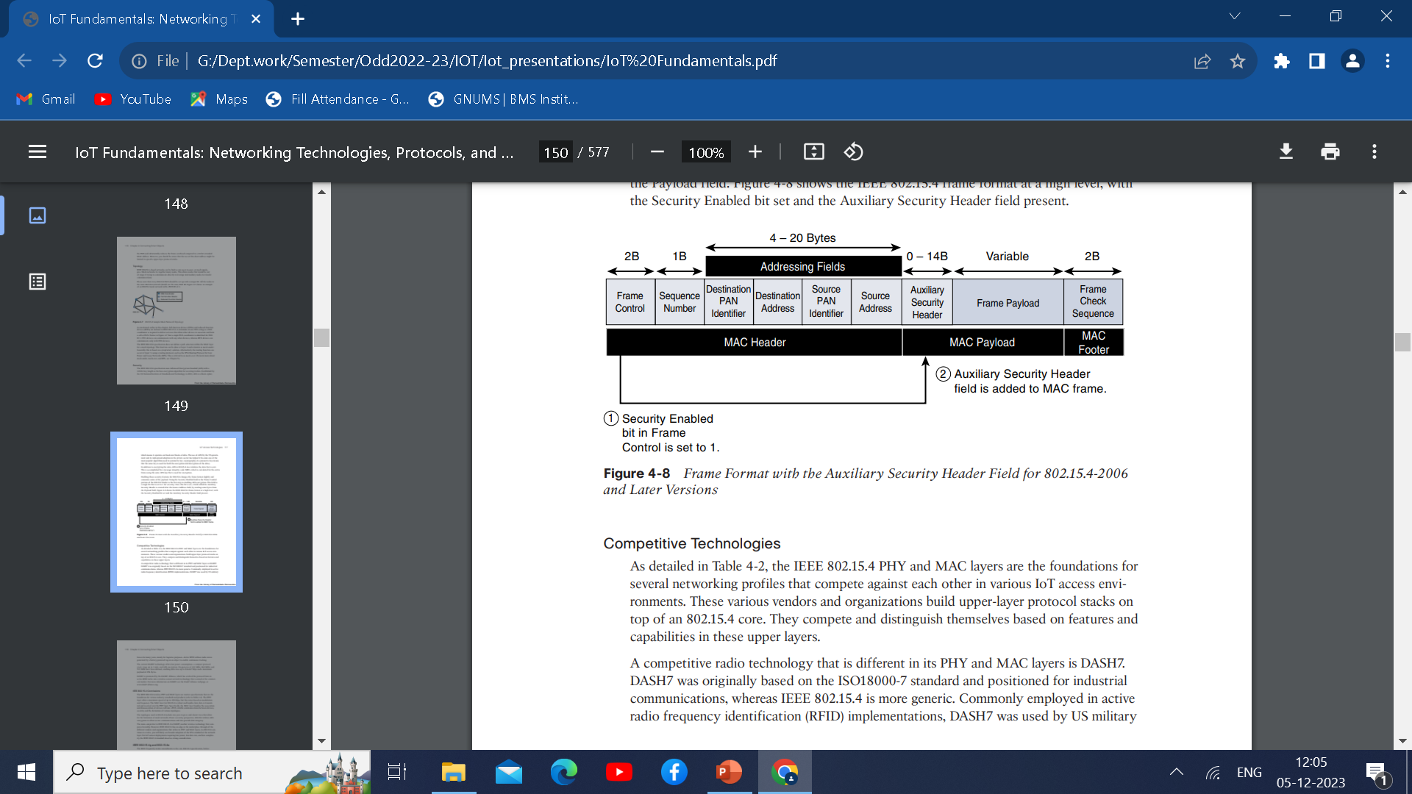
Enabling these security feature for 802.15.4 changes the frame format slightly and consumes some of the payload. Using the Security Enabled field in the Frame Control portion of the 802.15.4 header is the first step to enabling AES encryption.
This field is a single bit that is set to 1 for security. Once this bit is set, a field called the Auxiliary Security Header is created after the Source Address field, by stealing some bytes from the payload field.
The Security Enabled bit set and the Auxiliary Security field present.

Slide 44
Competitive Technologies
A competitive radio technology that is different in its PHY and MAC layers is DASH7.
DASH7 was originally based on the ISO18000-7 standard and positioned for industrial communications, whereas IEEE 802.15.4 is more generic. Commonly employed in active radio frequency identification (RFID) implementations, DASH7 was used by US military A competitive radio technology that is different in its PHY and MAC layers is DASH7.
DASH7 was originally based on the ISO18000-7 standard and positioned for industrial communications, whereas IEEE 802.15.4 is more generic. Commonly employed in active radio frequency identification (RFID) implementations, DASH7 was used by US military.

Slide 45
IEEE 802.15.4 Conclusions
The PHY layer offers a maximum speed of up to 250 kbps, but this varies based on modulation and frequency. The MAC layer for 802.15.4 is robust and handles how data is transmitted and received over the PHY layer.
Specifically, the MAC layer handles the association and disassociation of devices to/from a PAN, reliable communications between devices, security, and the formation of various topologies.
The topologies used in 802.15.4 include star, peer-to-peer, and cluster trees that allow for the formation of mesh networks. From a security perspective, 802.15.4 utilizes AES encryption to allow secure communications and also provide data integrity.
For IoT sensor deployments requiring low power, low data rate, and low complexity, the IEEE 802.15.4 standard deserves strong consideration.

Slide 46
IEEE 802.15.4g and 802.15.4e
Amendments are made to 802.15.4.
802.15.4e expands the MAC layer feature to overcome the disadvantages of 802.15.4 including reliability, unbounded latency and multipath fading.
IEEE 802.15.4e enhanced in the areas of frame format, security, determinism mechanism and frequency hopping.
802.15.4g optimize large wireless mesh networks for field area network(FAN)

Slide 47
Applied use cases
Distribution automation and industrial supervisory control and data acquisition (SCADA) environments for remote monitoring and control.
Public Lighting
Environment wireless sensors in smart cities
Electrical vehicle charging stations
Smart parking meters
Micro grids
Renewable energy

Slide 48
Standardization and Alliances
802.15.4g-2012 and 802.15.4e-2012 led additional difficulty in achieving the interoperability between devices and mixed vendors that users requested.
Commercial Name/Trade mark | Industry Organization | Standards Body
Wi-Fi | Wi-Fi Alliance | IEEE802.11 Wireless LAN
WiMAX | WiMAX Forum | IEEE802.11 Wireless MAN
Wi-SUN | Wi-SUN Alliance | IEEE 802.15.g Wireless SUN

